Slide 1
The role of CD4 in patient monitoring Amsterdam July 2018

Slide 2
Uses of CD4
Treatment eligibility
Treatment failure monitoring
Clinical management

Slide 3
History of guideline changes for treatment eligibility
2003 | Recommended for patients older than 5 years of age with CD4 cell count ≤ 200 cells/mm³
2006 | Recommended for patients older than 5 years of age with CD4 cell count ≤ 200 cells/mm³
2010 | Recommended for patients older than 5 years of age with CD4 cell count ≤ 3500 cells/mm³
2013 | Recommended for patients older than 5 years of age with CD4 cell count ≤ 500 cells/mm³
2016 | Treat All: all adults living with HIV, regardless of WHO clinical stage and at any CD4 cell count

Slide 4
Uses of CD4
Treatment eligibility
Treatment failure monitoring
Clinical management
Treat All

Slide 5
Uses of CD4
Treatment eligibility
Treatment failure monitoring
Clinical management
✗

Slide 6
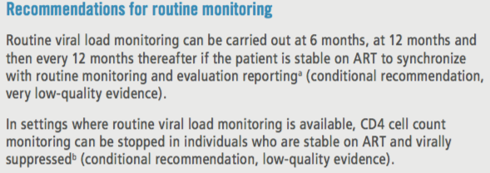
Uses of CD4
Treatment eligibility
Treatment failure monitoring
Clinical management
✗
Viral load

Slide 7
Uses of CD4
Treatment eligibility
Treatment failure monitoring
Clinical management
✗
✗

Slide 8
Uses of CD4
Treatment eligibility
Treatment failure monitoring
Clinical management
✗
✗
✓

Slide 9
Advanced disease: a persistent problem
38% of patients start ART with advanced HIV disease
Higher in LMIC and among men
The results are based on 951 855 adults from 55 countries
Source: IeDEA/COHERE–WHO Collaboration

Slide 10
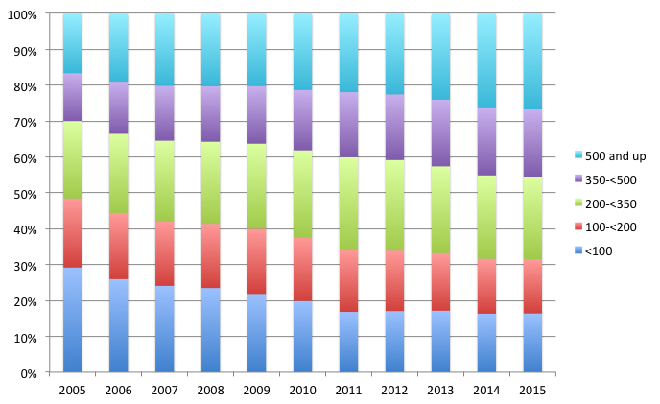
Country example of advanced HIV disease proportions
IAS 2017

Slide 11
Advanced HIV disease
Advanced HIV disease is defined as CD4 count < 200 cells/mm³ or WHO clinical stage 3 or 4.
(All children < 5 years old are considered having advanced disease.)
In a study from Kenya, Malawi, Uganda and Zimbabwe, almost half (47%) the people with CD4 count < 100 cells/mm3 were classified as having WHO clinical stage 1 or 2 disease. Hakim NEJM 2017

Slide 12
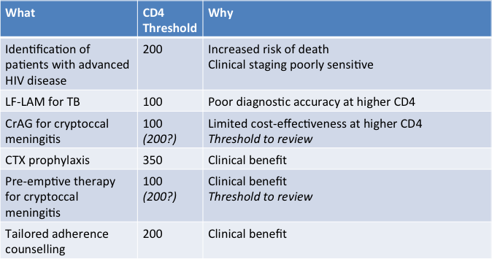
Advanced HIV disease package of care

Slide 13
Demand for CD4 tests: all LMIC
CD4 testing will be replaced by VL in routine monitoring
However, need for CD4 will remain for new ART initiates, and monitoring advanced disease in patients not virally suppressed
For patients with limited access to VL, CD4 will remain necessary for routine monitoring
Source: Consolidated forecast presented at AMDS meeting, Geneva, March 2018; CHAI projections for 18 high volume countries (74% of 2016 market) plus log extrapolations of past data for the remaining countries

Slide 14
Need and demand for CD4 tests: all LMIC
Need is estimated using projected ART patient numbers and country-level testing guidelines. Where national guidelines are unknown, the WHO’s recommendations of 1 test at baseline, 2 for those not covered by VL, and 2 for those failing VL are used.
Source: CHAI projections of 18 high-burden countries; (80% of people on ART in LMICs), supplemented by log extrapolations of “Rest of World” by Avenir Health. Forecast as of June 18, 2018.

Slide 15
CD4 capital capacity
Significant capacity exists to allow for continued CD4 testing to support identification of patients with advanced HIV disease.
Habiyambere PLoS Medicine 2016

Slide 16
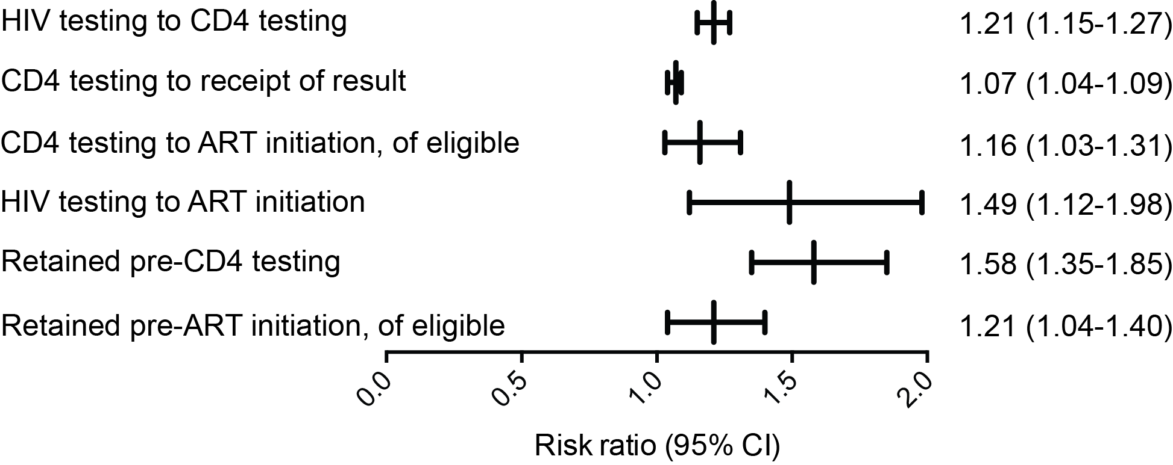
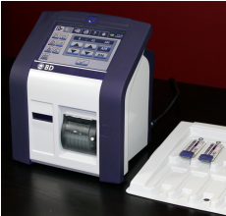
POC CD4 as a support tool

Slide 17
Conclusions
CD4 cell count testing at baseline for all patients, and particularly for assessment of patients presenting with signs and symptoms of advanced HIV disease, remains important.
Relying on clinical staging alone carries the risk of missing substantial numbers of patients with severe immune suppression.
Identification of patients with advanced HIV disease who are eligible for elements of a package of care is contingent on CD4 cell count testing.
Determining the immunological status of patients who are virologically failing can help guide clinical management decisions.

